Slide 1
Phishing Awareness Training

Slide 2
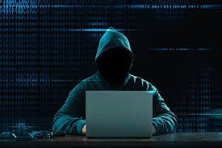
INTRODUCTION
Phishing is a type of scam through digital communication in order to obtain personal information such as usernames, passwords, credit card details, or other confidential information.
Phishing scammers typically use emails, text messages, and instant messages to lead targets to a fake website that looks legitimate and have them fill in their personal information.

Slide 3
Why is it called Phishing?
The first time the word “phishing” was used and recorded was around 1996 when hackers were stealing accounts and passwords from America Online. These hackers used email lures and “fished” for passwords and financial information from internet users.
The reason that the “ph” was used instead of the “f” in the spelling of the word is that some of the earliest hackers were known as “phreaks”, meaning the exploration, experimentation, and study of the telecommunication systems. The “ph” spelling was used because the phishing scams relate to these hacker communities.

Slide 4
TYPES OF PHISHING ATTACKS
There are various types of phishing attacks in today’s cyber world. Out of those, few are listed below which are known to have frequent occurance :
1) Email Phishing – Fradulent emails that appear legitimate.
2) Website Phishing -A phishing website (spoofed website) is a common deception tactic threat actors utilize to steal real login credentials to legitimate websites.
3) Social engineering- Social engineering is a manipulation technique that exploits human error to gain private information, access, or valuables.
4) Angler Phishing- Attacks using social media or messaging apps to trick victims into revealing sensitive information.
5) Vishing- Voice phishing attacks, where attackers use phone calls to trick victims into revealing sensitive information.
6) Smishing- Phishing attacks via SMS or text messages, often using urgent or threatening language to prompt action.

Slide 5
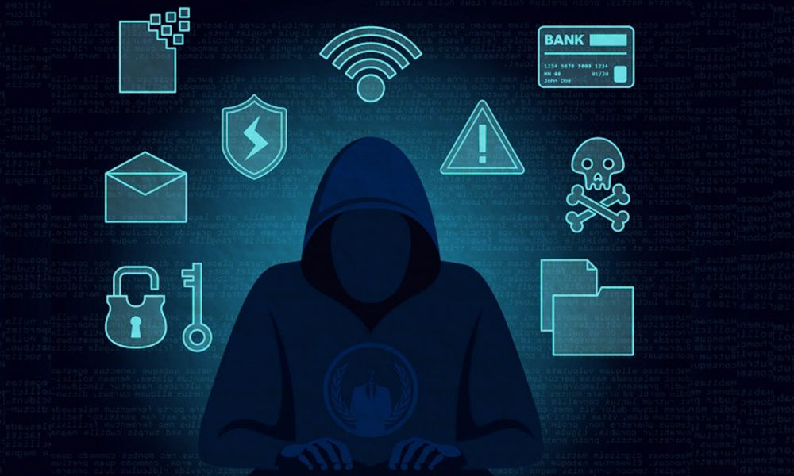
EMAIL PHISHING
Email phishing is a type of cyber attack where attackers send fake emails that appear to be from a legitimate source, such as a bank, online retailer, or social media platform, to trick victims into revealing sensitive information like passwords, credit card numbers, or personal data. These emails often create a sense of urgency, use threatening language, or promise enticing offers to prompt action. They may contain malicious links or attachments that download malware or viruses when clicked or opened. To avoid falling victim, it's essential to be cautious with links and attachments, verify sender information, and watch for spelling and grammar mistakes, urgent or threatening language, and requests for personal information.

Slide 6
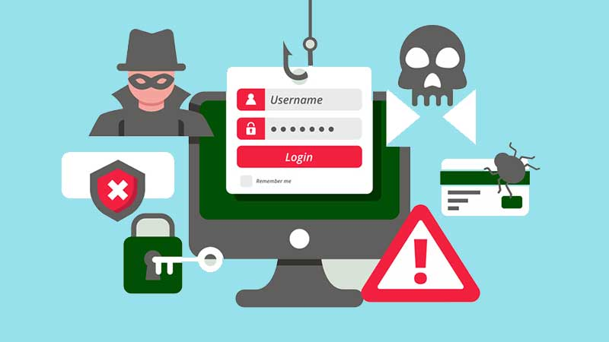
Website Phishing
Website phishing involves creating fake websites that mimic legitimate ones, aiming to trick victims into revealing sensitive information such as login credentials, credit card numbers, or personal data. These fake sites often have similar URLs, logos, and layouts to the genuine sites, making them difficult to distinguish. Attackers may use tactics like typo-squatting (registering similar domain names) or exploiting vulnerabilities in legitimate sites to redirect victims to their fake sites. Once on the fake site, victims may be prompted to enter sensitive information, which is then stolen by the attackers. To avoid falling victim, it's essential to verify the website's URL, look for HTTPS encryption, and be cautious of sites that request unnecessary information or have poor security measures in place.

Slide 7

Social Engineering
Social engineering is a manipulation technique used by attackers to trick individuals into revealing sensitive information, performing certain actions, or gaining access to systems. It exploits human psychology, leveraging trust, curiosity, and fear to bypass security measures. Attackers use tactics like pretexting (creating a fake scenario), baiting (leaving malware-infected devices), quid pro quo (offering services in exchange for information), and phishing (sending fake emails or messages) to deceive victims. By manipulating individuals, social engineering attacks can lead to unauthorized access, data breaches, and financial losses, making it a significant threat to individuals and organizations.

Slide 8
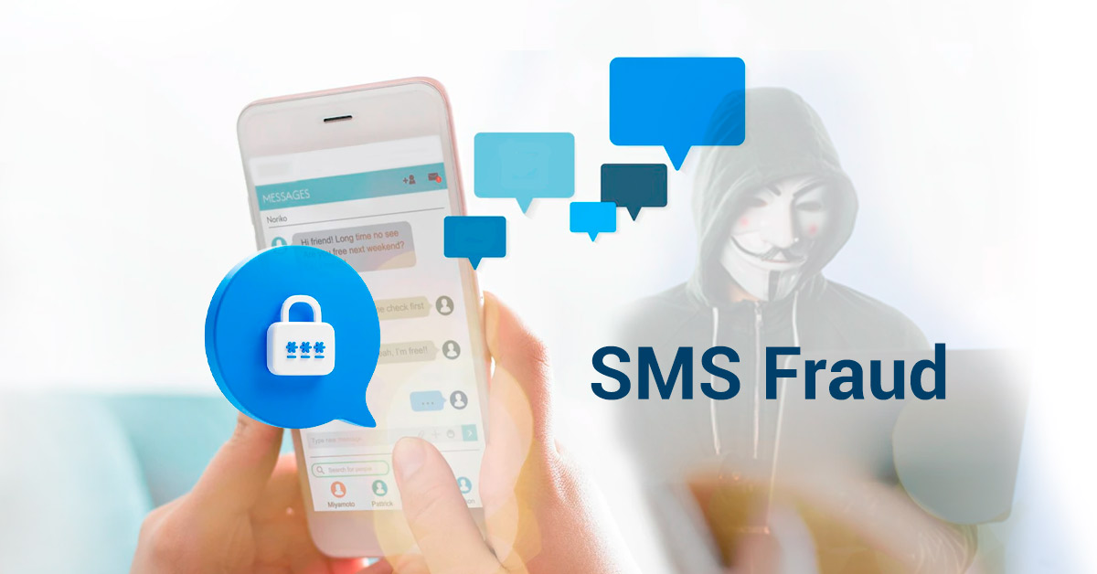
Common Phishing Tactics
Urgency: Creating a sense of urgency to prompt action, such as claiming an account will be closed or a service will be terminated.
Deception: Disguising the email or message to appear legitimate, using logos and branding to mimic a trusted source.
Curiosity: Piquing curiosity with intriguing subject lines or messages, encouraging clicks or downloads.
Authority: Impersonating authority figures, such as law enforcement or government agencies, to gain trust.
Baiting: Offering enticing offers or rewards to lure victims into revealing information or clicking on links.
Pretexting: Creating a fake scenario or story to gain trust and extract information.

Slide 9

Red Flags to recognize phishing attempt
1. Suspicious sender addresses or domains.
2. Spelling and grammar mistakes.
3. Urgent or threatening language.
4. Unusual attachments or links.
5. Requests for sensitive information.

Slide 10
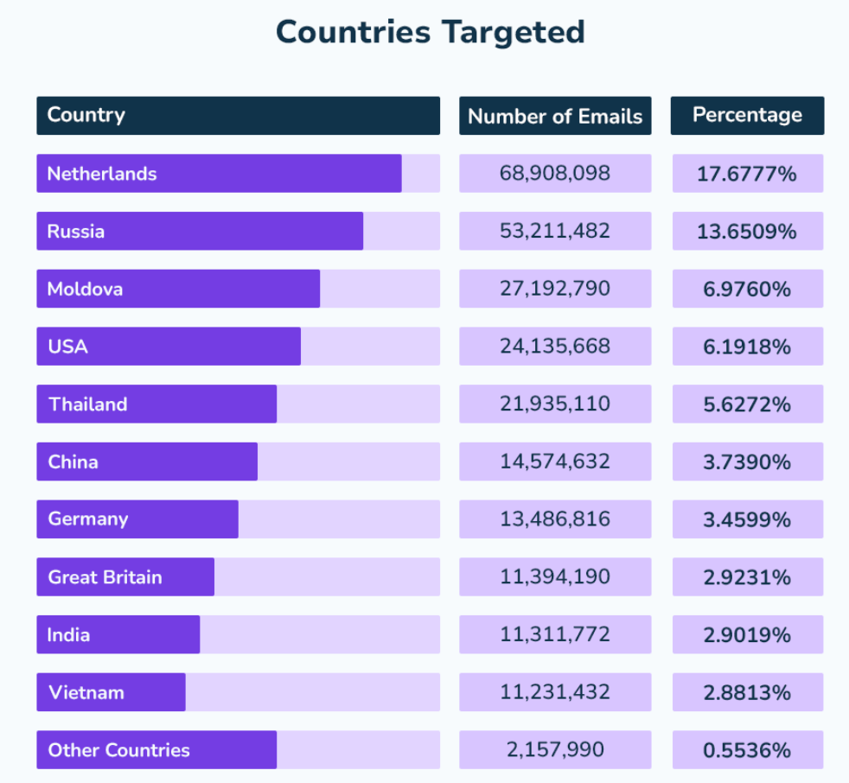
Following statistics describes the rate of Phishing attacks worldwide in the recent years
Email impersonation accounts for an estimated 1.2% of all email traffic globally.Around 36% of all data breaches involve phishing. 84% of organizations were the targets of at least one phishing attempt in 2022. A 15% increase on the year before.
In 2022, The Anti-Phishing Working Group, APWG, observed 1,350,037 total phishing attacks, up from 1,270,833 the previous quarter. Also, In 2022, APWG logged ~4.7 million phishing attacks. Since 2019, the number of phishing attacks has increased by more than 150% yearly.

Slide 11
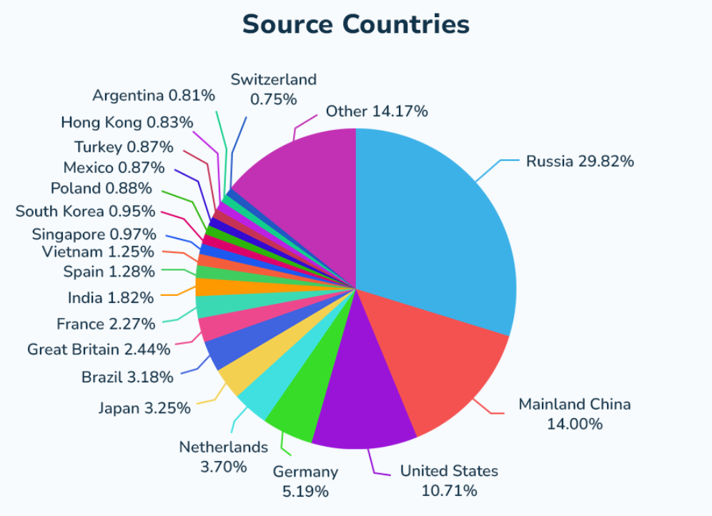
In 2022, 29.82% of spam emails were sent from Russia. Mainland China is the second most common source of malicious spam (14%), followed by the United States (10.71%).
Email is overwhelmingly the most popular method of conducting a phishing attack. An estimated 91% of all cyber attacks begin with a phishing email.
91% of bait emails are sent via Gmail accounts. Reasons for the popularity of Gmail with threat actors are thought to include the ability to set up large numbers of accounts quickly and for free and the availability of Google’s inbuilt “read receipts” function.
Notwithstanding the dominance of email, a third of IT professionals report an increase in other message-related platforms.
44% of respondents have experienced phishing via video conferencing platforms, 40% via workplace management platforms, 40% via file-sharing platforms, and 36% via text messages.

Slide 12
How to Respond to a Phishing Attempt?
1. Don’t Engage: Do not respond to the email, click on links, or download attachments.
2. Report It: Report phishing emails to your organization’s IT department. Forward the email to a phishing reporting service (e.g., phishing-report@us-cert.gov).
3. Delete It: After reporting, delete the phishing email from your inbox.
4. Monitor Your Accounts: Regularly check your bank accounts, credit reports, and online profiles for unauthorized activity.

Slide 13
Tools and Resources for Phishing Protection
Email Filtering: Use advanced email filters to detect and block phishing emails.
Anti-Virus Software: Keep your anti-virus software up to date to catch malware from phishing attacks.
Password Managers: Use password managers to generate and store strong, unique passwords.
Multi-Factor Authentication (MFA): Enable MFA to add an extra layer of security to your accounts.

Slide 14
Conclusion
Always be vigilant when dealing with unsolicited communications. Use the provided tools and resources to protect yourself. Report and delete suspicious emails

Slide 15
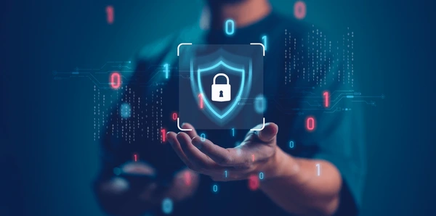
Thank you

